Slide 1
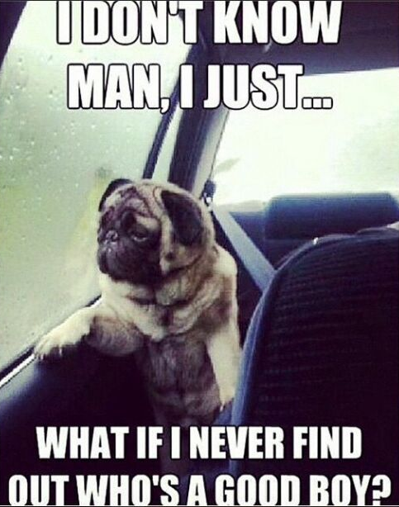
Timeline
Planning test Unit 2
Planning oral exams
Work from the book last week
Tomorrow answers online in wikiwijs
Tomorrow question hour
Notes:
Afbeelding: https://www.flickr.com/photos/studiodxavier/6063335422

Slide 2
Planning Test Unit 2
Date
March 15: Lesgroep 1
March 22: Lesgroep 2
What to learn
Level 1
Bladzijde 36 t/m 39: Woorden en Uitdrukkingen N – E en E – N
Level 2
Vocabulary: Unit 2 A2 (blz. 286 – 287) + Expressions Unit 2 (Level 2)
Past Simple en onregelmatige werkwoorden (Worksheet)
Present Perfect (Worksheet)
Word order – Woordvolgorde (Worksheet)
Level 3
Vocabulary: Unit 2 A2 + B1 (blz. 286 – 287) + Expressions Unit 2 (Level 2 + 3)
Same grammar
Level 4
Vocabulary: Unit 2 A2 + B1 + B2 (blz. 286 – 287) + Expressions Unit 2 (Level 2+3+4)
Same grammar

Slide 3
Planning Oral exams
Week | DV21 B
2 |  | Ashley Kimberly
3 |  | Indy
4 |  | Sanne Lars G.
5 | Test: Vocab + Grammar | Lars A. Lara Esmée
6 |  | Kevin Roos
7 |  | Wander Zoe Iris
8
9
10 | Test: Vocab + Grammar + Listening

Slide 4
Self study
Work
Writing assignment from Word order work sheet
Assignments from the book
Answers
Tomorrow answers online in wikiwijs
Tomorrow question hour

Slide 5
Introduction Unit 3
Planner
Vocab
Level 1
Level 2
Level 3
Level 4
Grammar
Future tense
Adverbs and Adjectives
Listening

Slide 6
How to practice listening
Level 1: Wikiwijs
Level 2 + 3 + 4: Studiemeter.nl
Log in or ask me for your username and password
Look at the next pages

Slide 8
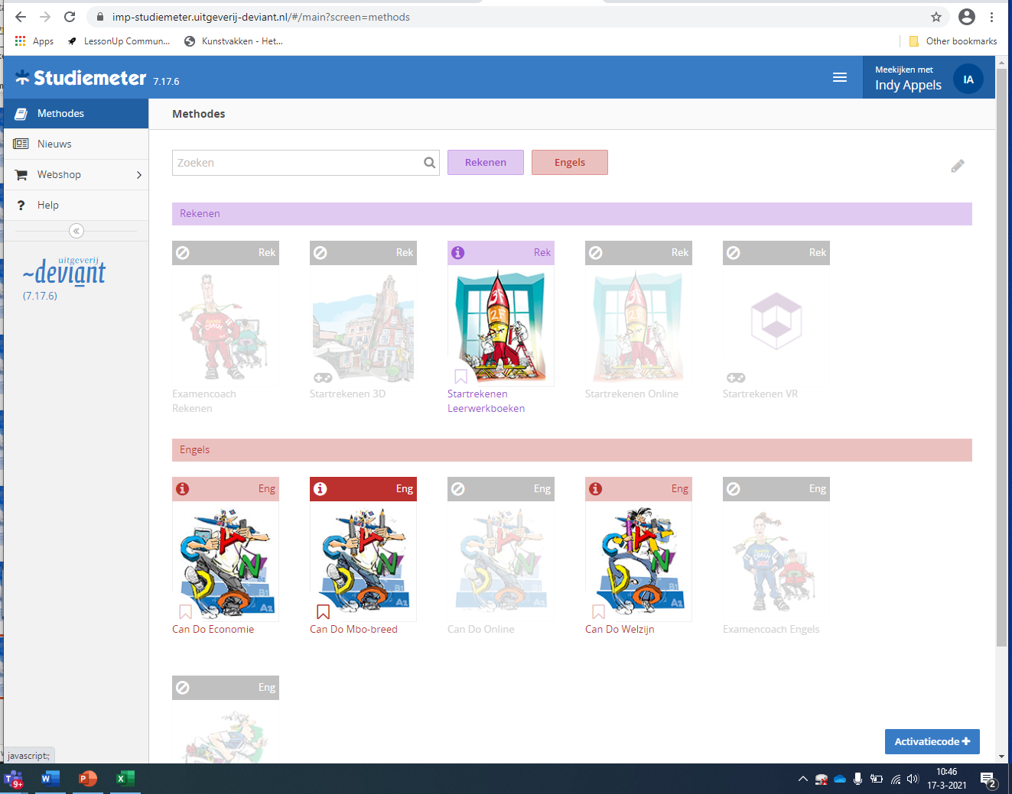

Slide 9
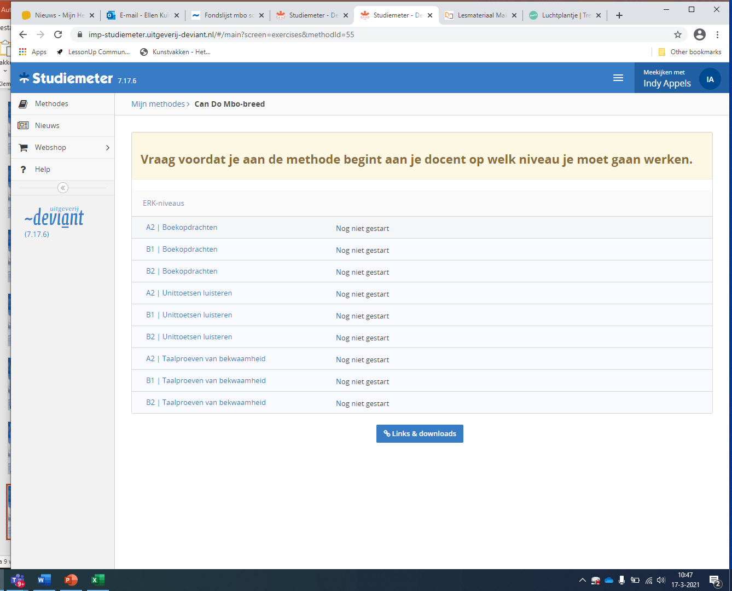

Slide 10
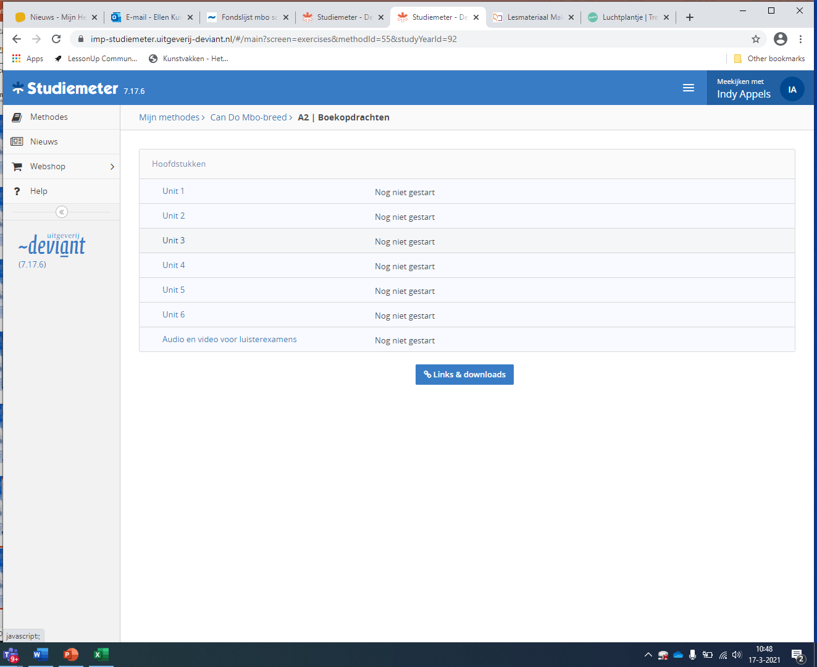

Slide 11
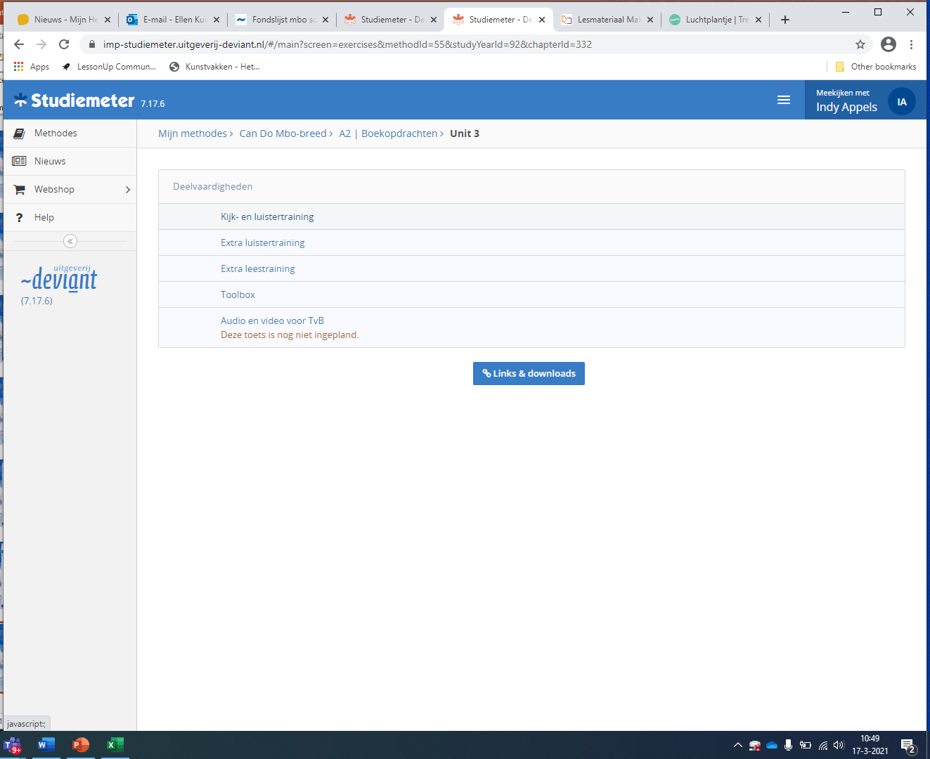

Slide 12
